Slide 1
PIP4004 - INTERNSHIP Review-2 Presentation
SALESFORCE.com CRM in ANUNAADHA SOLS LLP
Student Details
Name | Neha HD
Roll No | 20211CSE0519
Section | 8CSE04
Batch No. | CSE-26
Under the Supervision of,
Ms./Prof. Azad Mohammad Khan
Professor / Associate Professor / Assistant Professor
School of Computer Science and Engineering
Presidency University
Name of the Program: B.tech
Name of the HoD: Dr. Asif Mohammed H.B
Name of the Program Project Coordinator: Dr. Sampath A K / Dr. Abdul Khadar A
Name of the School Internship Coordinators: Mr. Md Ziaur Rahman

Slide 2
Content
About Company or Organization
Working domain or the technology
About your team and reporting Manager
Challenges Faced in Internship
Objectives of the work
Literature Review
Proposed System
Problem Statement
System Requirements
Advantages of Proposed System/Work
Internship Roadmap
Github Link

Slide 3
About Company or Organization
Salesforce, Inc. is an American cloud-based software company headquartered in San Francisco, California.
It provides applications focused on e-commerce, analytics, artificial intelligence.
Other services include app creation, data integration and visualization, and training.
Salesforce Platform (formerly known as Force.com) is a platform as a service (PaaS)

Slide 4
About Company or Organization
Sales Cloud – Helps businesses manage sales processes, leads, and customer interactions.
MuleSoft – An integration platform that connects various applications and data sources.

Slide 5
Working domain or the technology
Assigned as a web developer and worked to manage data intigration and storage.
Revenue Cloud – Helps businesses manage billing, subscriptions, and revenue recognition.
Einstein AI – Salesforce’s AI-powered analytics and automation tool for predictive insights, personalized recommendations, and natural language processing (NLP).

Slide 6
About your team and reporting Manager
Manjunatha C Holekade (Director, Anunaadha Sols LLP) is our reporting manager.

Slide 7
Challenges Faced in Internship
Ex: challenges faced in searching Internship, cracking the interview, getting adjusted with the team etc.

Slide 8
Objectives of the work
Data handling
Use for the easy interaction of all the data in a single screen and help in the scheduling of the work and the time line.
Ex: Purpose and usage of your work.

Slide 9
Literature Review
Customer Relationship Management (CRM) is a strategic approach that focuses on building and maintaining long-term relationships with customers to enhance business performance.
Benefits of CRM Implementation Studies have highlighted numerous benefits of CRM implementation, including enhanced customer satisfaction, increased customer retention, improved efficiency, and better decision-making capabilities

Slide 10
Literature Review
Challenges in CRM Adoption: high implementation costs, and data security concerns are among the key issues faced by organizations
Technological Advancements in CRM: transformed the way businesses interact with customers. Modern CRM systems leverage artificial intelligence, machine learning, and big data analytics to enhance customer insights and predictive analytics

Slide 11
Proposed System / Work
To build a basic CRM with Lead Management.

Slide 12
Problem Statement
Customer spending more time and effort for managing Leads with excel and other applications.

Slide 13
System Requirements
Basic computer/laptop with Internet connection.

Slide 14
Advantages of Proposed System/Work
Ready to use application with easy to scale-up options with subscription based billing.

Slide 15
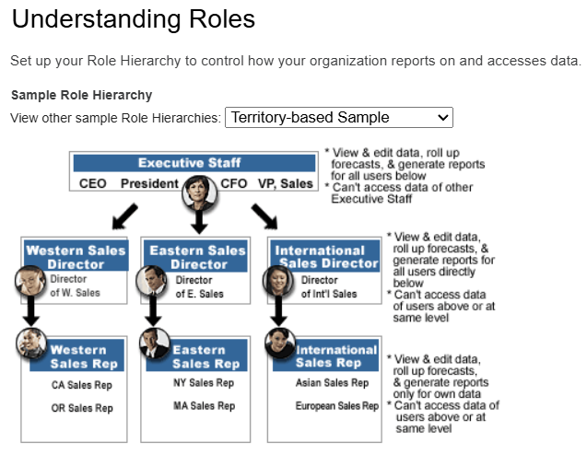
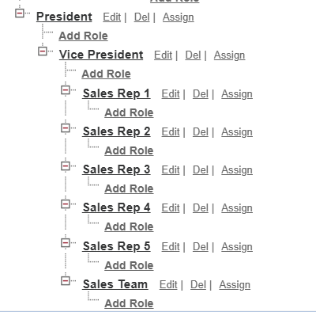
ROLES IN PROJECT

Slide 16
Internship Road Map
Review 0
Review 1
Litrature Review and solution for algorithms
Review 2
50% Implementation
Review 3
100% Implementation
Understanding

Slide 17
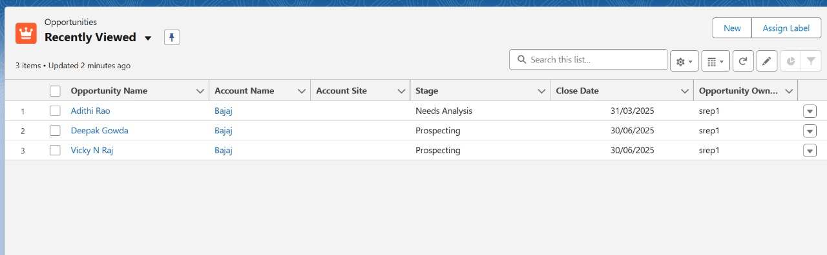
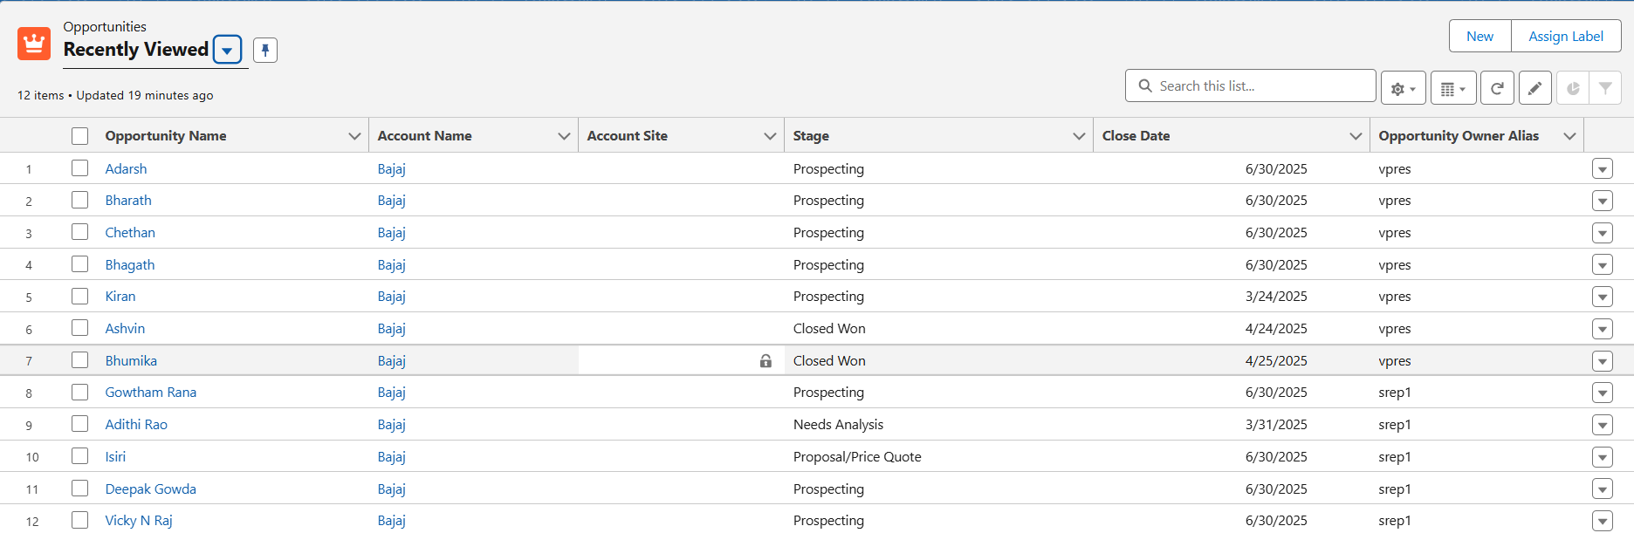
OUTPUT
Sales rep View V/S Vice-President View

Slide 18
Thank you !!

